Slide 1
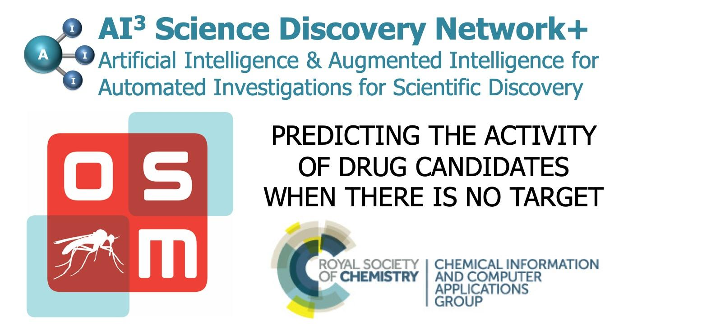
WHAT: A one-day meeting in London on the application of machine learning/artificial intelligence (ML/AI) approaches to drug discovery, specifically cases where the biological target is not clearly established - so-called phenotypic drug discovery.
WHEN: Friday Jan 31st 2020, 10am—4pm
WHERE: The Royal Society of Chemistry, Burlington House, Piccadilly, London, W1J 0BD
WHY: We will be conducting a post-mortem on a predictive modeling competition run by Open Source Malaria (OSM) to which speakers at the conference submitted solutions. We will be reviewing which approaches worked and which did not – i.e. a real-world case study of AI/ML in drug discovery.
HOW MUCH: Free, but registration is essential.
Register: https://www.eventbrite.co.uk/e/ai-and-ml-in-drug-discovery-predicting-bioactive-molecules-when-there-is-no-target-tickets-88690015223
GitHub Repository: https://github.com/OpenSourceMalaria/Series4_PredictiveModel
Contact: Samantha Kanza - s.kanza@soton.ac.uk

